Slide 1

15ECC18 – SENSORS AND ACTUATORS

Slide 2
UNIT IV – ELECTRIC, MAGNETIC, SENSORS AND ACTUATORS
The Electric Field: Capacitive Sensors and Actuators
Magnetic Fields: Inductive sensors and Hall effect sensors
Magneto hydrodynamic (MHD) Sensors and Actuators
Magnetometers
Magnetic Actuators
Voltage and Current Sensors

Slide 3
INTRODUCTION
Sensors and actuators based on electric and electrostatic principles, including capacitive sensors (proximity, distance, level, material properties, humidity, and other quantities such as force, acceleration, and pressure) and related electric field sensors and actuators. This class of sensors includes microelectromechanical (MEMs) devices.
Sensors based on direct measurement of resistance. There are many sensors that belong in this category, including both AC and DC sensing of current and voltage, position and level sensing, and many others.
Magnetic sensors and actuators based on the static and low-frequency time-dependent magnetic field. The variety here is large. It includes motors and valves for actuation, magnetic field sensors (hall element sensors, inductive sensors for position, displacement, proximity, etc.), and a variety of others, including magnetostrictive and magnetoresistive sensors and actuators .
A fourth group of electromagnetic sensors, based on radiation effects of the electromagnetic field.

Slide 4
INTRODUCTION
Definitions:
An electric field is the force per unit charge that exists in the presence of charges or charged bodies. An electric field may be static when charges do not move or move at constant velocity or may be time dependent if charges accelerate and/or decelerate.
Moving charges in conducting media or in space cause currents and currents produce magnetic fields. Magnetic fields are either static, when currents are constant (DC),or time dependent, when currents vary in time.
When currents vary in time, both an electric and a related magnetic field are established. This is called an electromagnetic field. Strictly speaking, an electromagnetic field implies that both an electric and a magnetic field exist.
Electromagnetic actuators are based on one of the two basic forces: electric force (best understood as the attraction between opposite polarity charges or repulsion between like polarity charges) and magnetic force.

Slide 5
UNITS
Units:
The basic SI electric unit is the ampere (A) - current per unit length (ampere/meter [A/m])
Charge itself has units of coulombs (C) or ampere-seconds (A.s), but charge is often encountered as a density: coulomb/meter (C/m), coulomb/square meter (C/m²), or coulomb/cubic meter (C/m³).
The volt (V) or as joules/coulomb (J/C), newton-meter/coulomb (Nm/C)
watt or the ampere-volt (A.V) – watt-time, such as the watt-hour (W.h) or one of its multipliers such as kWh.
Energy density (per unit volume) is used to signify energy storage capacity in joules/cubic meter (J/m³)

Slide 6
UNITS
Units:
Resistance
Conductivity
Electric permittivity and magnetic permeability (ratio between magnetic flux density and magnetic field intensity)
Capacitance
Electric field intensity
Electric flux density (product of the electric field intensity and permittivity)
Magnetic flux density
Inductance (The ratio of magnetic flux and current )
Magnetic reluctance or reluctivity

Slide 7
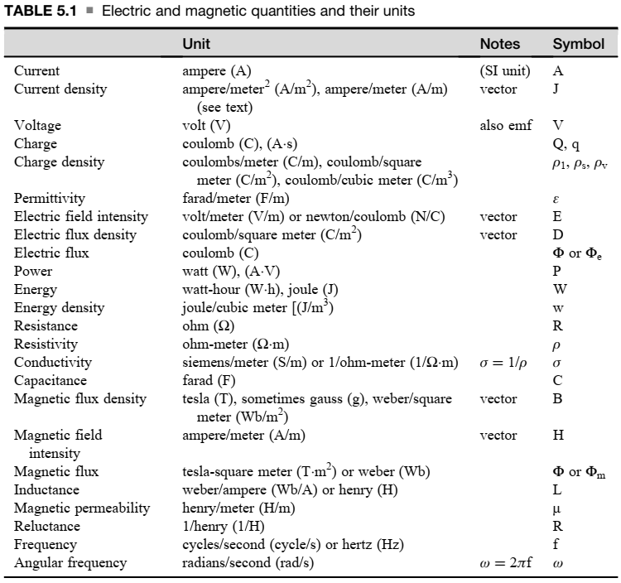
UNITS

Slide 8
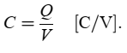
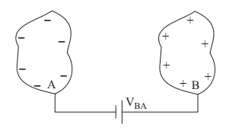
THE ELECTRIC FIELD: CAPACITIVE SENSORS AND ACTUATORS
Introduction:
All capacitive sensors are based on the change in capacitance due to the stimulus either directly or indirectly.
Capacitance is measured in coulombs/volt (C/V). This unit is called the farad (F)

Slide 9
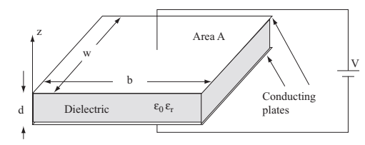
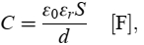
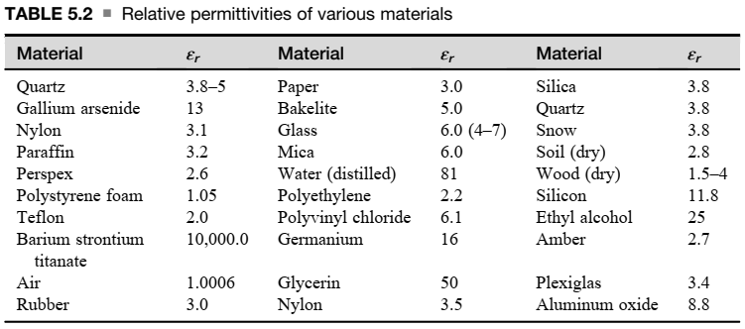
THE ELECTRIC FIELD: CAPACITIVE SENSORS AND ACTUATORS
Introduction:
This allows for a wide range of stimuli, including displacement and anything that can cause displacement (pressure, force), proximity, permittivity (e.g., in moisture sensors), and a myriad of others

Slide 10
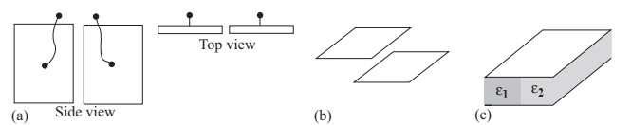
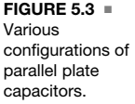
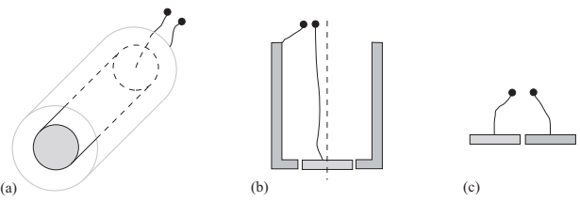
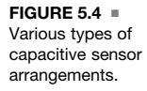
THE ELECTRIC FIELD: CAPACITIVE SENSORS AND ACTUATORS
Introduction:

Slide 11
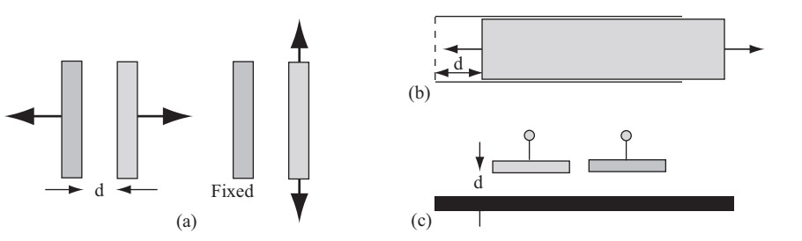
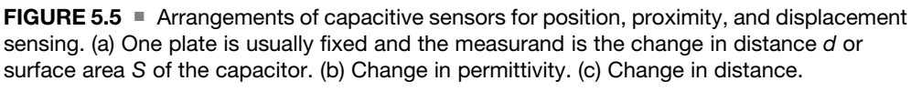
THE ELECTRIC FIELD: CAPACITIVE SENSORS AND ACTUATORS
Capacitive Position, Proximity, and Displacement Sensors
Position and displacement can be used to change the capacitance of a device in three fundamental ways :

Slide 12
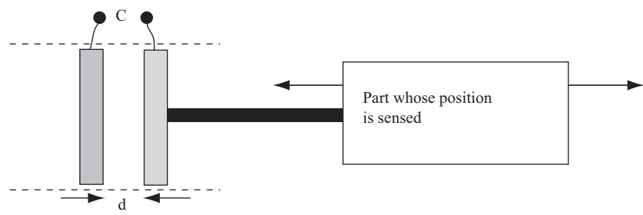
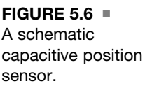
THE ELECTRIC FIELD: CAPACITIVE SENSORS AND ACTUATORS
Capacitive Position, Proximity, and Displacement Sensors
By allowing one conductor in a two-conductor capacitor (usually a plate) to move relative to the other. A number of configurations are shown in Figure 5.5. In Figure 5.5a, the sensor is made of a single plate while the second plate is a conductor relative to which the distance (proximity) is sensed. While this is a valid method, it is not a sensor one can obtain ready-made, but rather one has to build it, and this implies that proximity can only be sensed with respect to a conducting surface. A schematic position sensor of this type is shown in Figure 5.6. One plate is fixed while the other is pushed by the moving device. The position of the moving device causes a change in position of one of the plates, and this changes the capacitance. The capacitance is inversely proportional to distance, and as long as the distances sensed are small, the output is linear .

Slide 13
THE ELECTRIC FIELD: CAPACITIVE SENSORS AND ACTUATORS
Capacitive Position, Proximity, and Displacement Sensors
Alternatively, the plates remain fixed but the dielectric moves in or out, as in Figure 5.5b. This is a practical situation for some applications. For example, the dielectric may be connected to a float that then senses the fluid level, or it may be pushed by a device to sense the end of travel or position. The advantage of this device is that it is quite linear, and the range of motion is rather large since it can approach the width of the capacitor.
Another configuration is obtained by keeping the plates fixed, as in Figure 5.5c, and sensing the distance to a surface. This is a practical arrangement since the sensor is self-contained and requires no external electrical connections or physical arrangements to sense distance or position. However, the relation between capacitance and distance is nonlinear and distance is limited because the electric field does not extend very far.

Slide 14
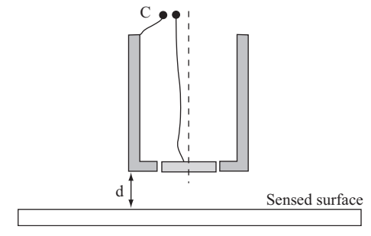
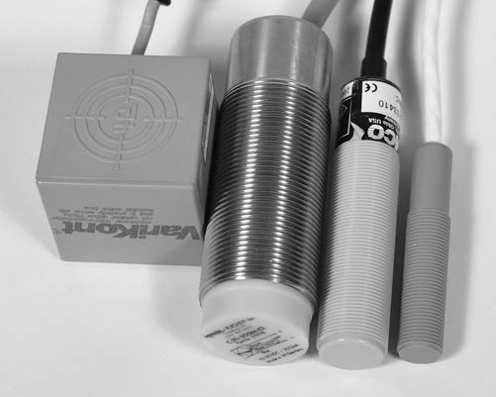
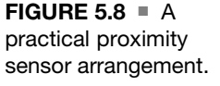
THE ELECTRIC FIELD: CAPACITIVE SENSORS AND ACTUATORS
Capacitive Position, Proximity, and Displacement Sensors

Slide 15
THE ELECTRIC FIELD: CAPACITIVE SENSORS AND ACTUATORS
Capacitive Position, Proximity, and Displacement Sensors
A hollow cylindrical conductor forms one plate of the sensor, as in Figure 5.8. The second plate of the sensor is a disk at the lower opening of the cylinder. The whole structure may be enclosed with an outer conducting shield or may be encased in a dielectric enclosure.
The capacitance of the device is C₀ based on dimensions, materials, and structure. When any material is present in the proximity of the lower disk, it changes the effective permittivity seen by the sensor and its capacitance increases to indicate the distance between the sensor and the surface.
The advantage of this sensor is that it can sense distances to conducting or nonconducting bodies of any shape, but the output is not linear. Rather, the smaller the sensed distance d, the larger the sensitivity of the sensor.
Large-diameter sensors will have a larger span but relatively low sensitivity, whereas smaller diameter sensors will have a smaller span with greater sensitivity.

Slide 16
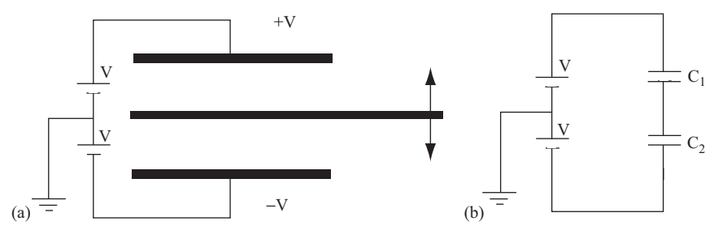
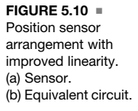
THE ELECTRIC FIELD: CAPACITIVE SENSORS AND ACTUATORS
Capacitive Position, Proximity, and Displacement Sensors

Slide 17
THE ELECTRIC FIELD: CAPACITIVE SENSORS AND ACTUATORS
Capacitive Position, Proximity, and Displacement Sensors
Capacitive position and proximity sensors may be made in other ways. One example is the sensor shown in Figure 5.10. The sensor has two fixed plates and one moving plate. When the plate is midway, its potential is zero with respect to ground since C₁ = C₂. As the plate moves up, its potential becomes positive (C₁ increases, C₂ decrease). When it moves down it is negative (C₂ increases, C₁ decreases).
A sensor of this type tends to be more linear than the previous sensors, but the distance between the fixed plates must be small and consequently the motion must also be small or the capacitances will be very small and difficult to measure.

Slide 18
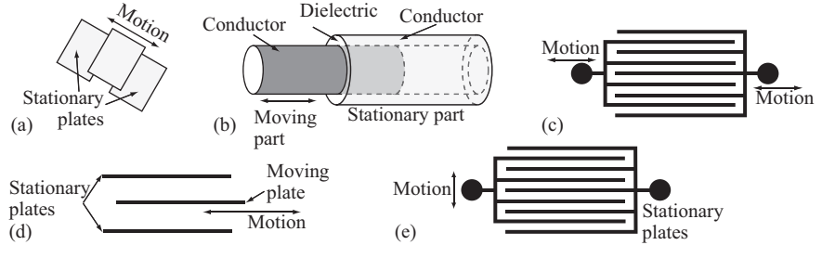
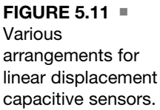
THE ELECTRIC FIELD: CAPACITIVE SENSORS AND ACTUATORS
Capacitive Position, Proximity, and Displacement Sensors
Other capacitive sensors sense rotary motion by rotating one plate with respect to the other. Still others are cylindrical or made in any convenient shape such as a comb shape.

Slide 19
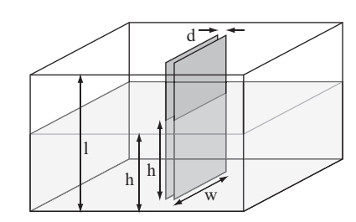
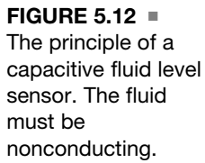
THE ELECTRIC FIELD: CAPACITIVE SENSORS AND ACTUATORS
Capacitive Fluid Level Sensors

Slide 20
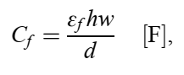
THE ELECTRIC FIELD: CAPACITIVE SENSORS AND ACTUATORS
Capacitive Fluid Level Sensors
One of the simplest, direct methods for fluid level sensing is to allow the fluid to fill the space between the two conducting surfaces that make up the capacitor. For example, the capacitance of the parallel plate capacitor is linearly proportional to the permittivity between the two plates.
Therefore the larger the amount of water between the plates, the larger the capacitance and therefore the capacitance is a measure of fluid level between the plates. Figure 5.12 shows a parallel plate capacitor used as a fluid level sensor.
The part of the plates under the surface of the water has a capacitance C_{f} .

Slide 21
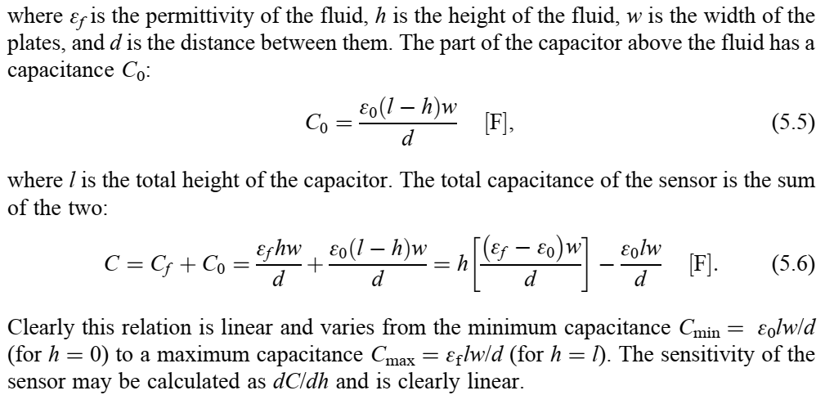
THE ELECTRIC FIELD: CAPACITIVE SENSORS AND ACTUATORS
Capacitive Fluid Level Sensors

Slide 22
THE ELECTRIC FIELD: CAPACITIVE SENSORS AND ACTUATORS
Capacitive Fluid Level Sensors
Although a parallel plate capacitor can be used for this purpose, the expressions above are approximate (they neglect the effect of the edges by assuming the field is not affected by the finite size of the plates).
In reality there will be a slight nonlinearity due to these effects and this nonlinearity depends on the distance between the plates.
Also, it should be noted that the method is only practical with nonconducting fluids (oils, fuels, freshwater). For slightly conducting fluids, the plates must be coated with an insulating medium

Slide 23
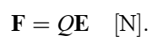
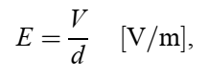
THE ELECTRIC FIELD: CAPACITIVE SENSORS AND ACTUATORS
Capacitive Actuators
When a potential is connected across the two conductors, they acquire opposite sign charges. These charges attract each other based on Coulomb’s law and this force tends to pull the two conductors closer together. Coulomb’s law defines the force between the charge and the electric field intensity. Given a charge Q [C] in an electric field intensity E [V/m], a force F is exerted on the charge by the electric field as,
In a parallel plate capacitor, the magnitude of the total electric field intensity (i.e., the sum of the electric field produced by the upper and lower charged plates) is given as,
where the direction is perpendicular to the plates and the electric field intensity points from the positively charged plate to the negatively charged plate.

Slide 24
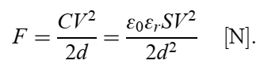
THE ELECTRIC FIELD: CAPACITIVE SENSORS AND ACTUATORS
Capacitive Actuators
The force is found by substituting Q in Equation (5.7) with Equation (5.1) and E from Equation (5.8), except that the electric field intensity in Equation (5.8) must be divided by 2, that is, the force produced by the lower plate on the upper plate is the electric field intensity of the lower plate at the location of the upper plate multiplied by the charge of the upper plate.
The capacitance of the parallel plate capacitor is given in Equation (5.2). Putting all these together, the force is

Slide 25
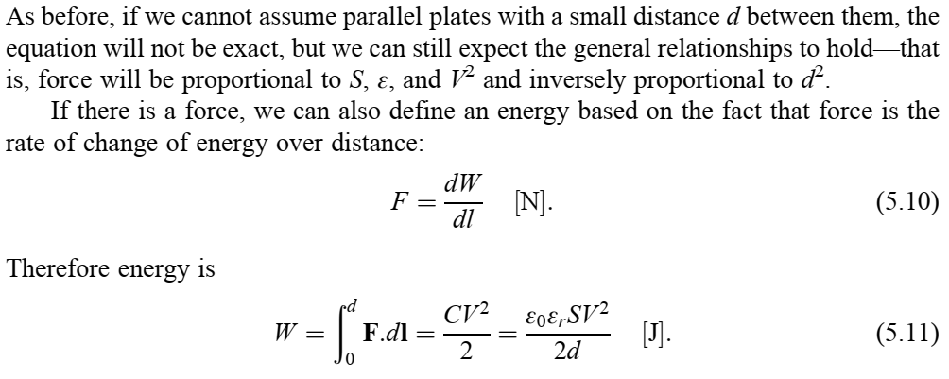
THE ELECTRIC FIELD: CAPACITIVE SENSORS AND ACTUATORS
Capacitive Actuators

Slide 26
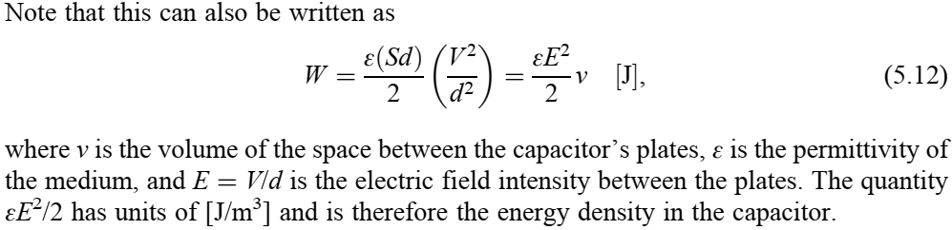
THE ELECTRIC FIELD: CAPACITIVE SENSORS AND ACTUATORS
Capacitive Actuators

Slide 27
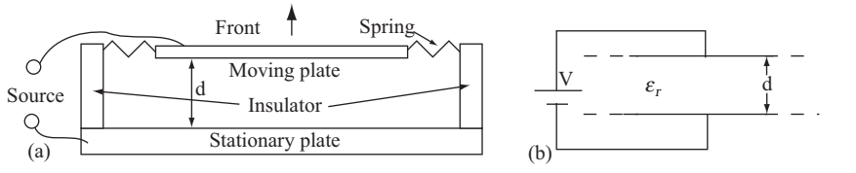
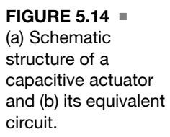
THE ELECTRIC FIELD: CAPACITIVE SENSORS AND ACTUATORS
Capacitive Actuators
Given a fixed conductor, a second conductor, if connected to a potential difference with respect to the first, will move with respect to the fixed conductor. This is shown schematically in Figure 5.14.
This motion may be used for positioning or, as is the case here, as an electrostatic loudspeaker.

Slide 28
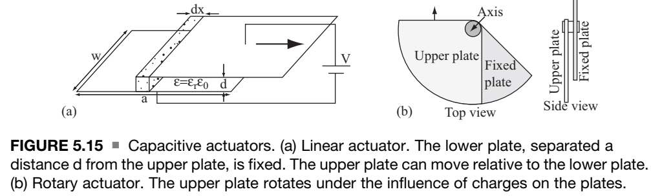
THE ELECTRIC FIELD: CAPACITIVE SENSORS AND ACTUATORS
Capacitive Actuators

Slide 29
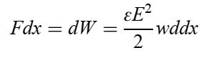
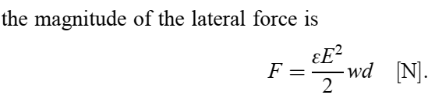
THE ELECTRIC FIELD: CAPACITIVE SENSORS AND ACTUATORS
Capacitive Actuators
The obvious vertical attraction between two plates of a parallel plate capacitor is not the only mechanism for electrostatic actuation. Consider the asymmetric configuration of the two plates of a parallel plate capacitor in Figure 5.15a.
The two plates attract each other, but now the force has a vertical and a horizontal component. The plates not only will attract and try to close the distance between them, but also to close the horizontal separation. This basic method may also be used to affect rotational motion using the device in Figure 5.15b.
Here the distance between the plates is fixed, but the plates can rotate with respect to each other and will tend to do so until they are positioned exactly overlapping each other. With the addition of a spring to restore the initial position, this can be made into a very accurate positioner.
The forces involved can be calculated from the virtual displacement principle, as follows: Using again the plates in Figure 5.15a, suppose we allow the upper plate to move a ‘‘virtual’’ distance dx to the left.

Slide 30
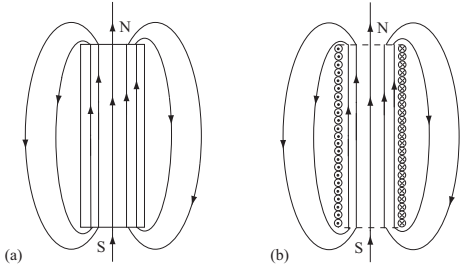
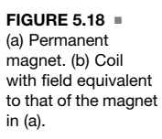
MAGNETIC FIELDS: SENSORS AND ACTUATORS
Introduction

Slide 31
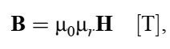
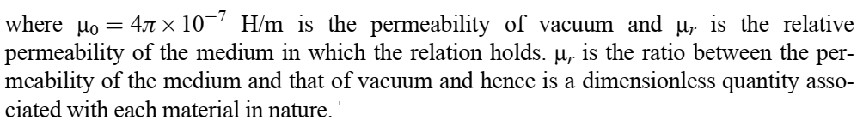
MAGNETIC FIELDS: SENSORS AND ACTUATORS
Introduction
The ‘‘strength’’ of the magnetic field is usually given by the magnetic flux density, B [T], or the magnetic field intensity, H [A/m]. The relation between the two fields is

Slide 32
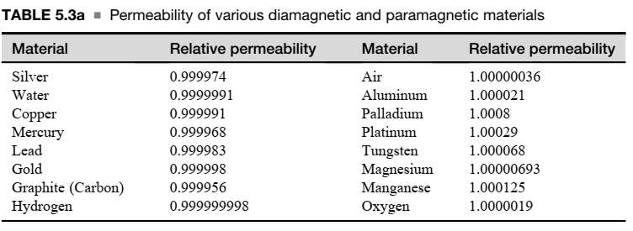
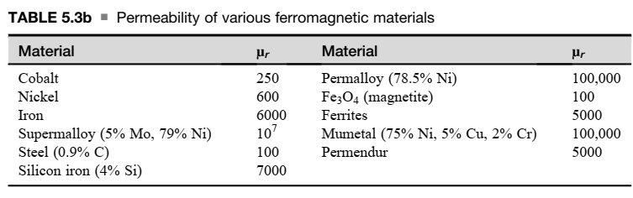
MAGNETIC FIELDS: SENSORS AND ACTUATORS
Introduction

Slide 33
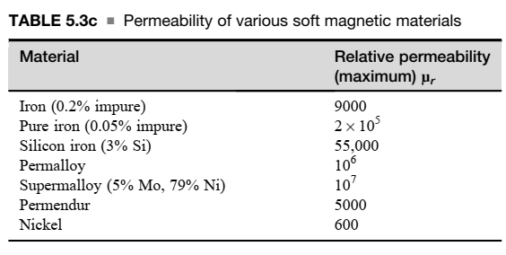
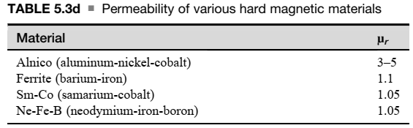
MAGNETIC FIELDS: SENSORS AND ACTUATORS
Introduction

Slide 34
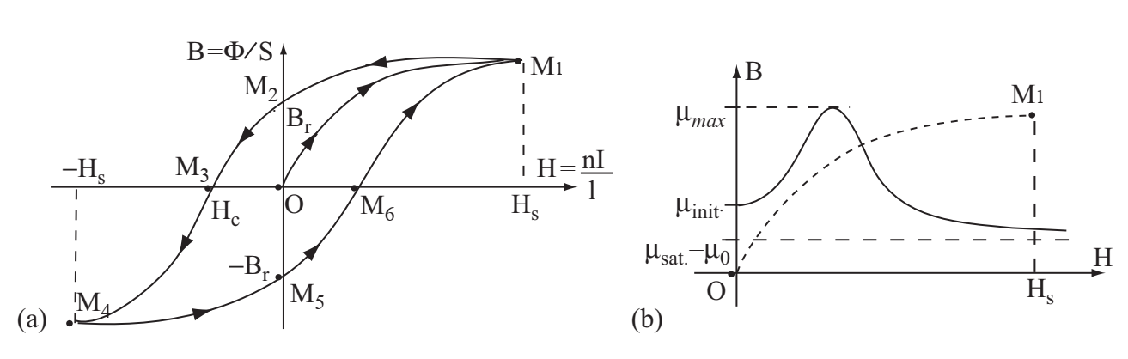
MAGNETIC FIELDS: SENSORS AND ACTUATORS
Introduction
Soft magnetic materials are those in which magnetization is reversible (i.e., they do not become permanent magnets following application of an external magnetic field).
Hard magnetic materials are materials that retain magnetization and therefore are often used for production of permanent magnets.

Slide 35
MAGNETIC FIELDS: SENSORS AND ACTUATORS
Introduction
It indicates that as the magnetization changes (as shown by the change in magnetic field intensity), the curve traces different paths as the magnetization increases and as it decreases.
The area of the magnetization curve is associated with losses.
From a sensing point of view it is important to understand that the narrower the curve, the easier it is to reverse magnetization. This indicates that these materials are appropriate as magnetic cores in structures such as electric motors or transformers, especially those operating on alternating currents.
Wide magnetization curves mean that the magnetization is not easily reversed, and these are usually materials used in permanent magnets.
Permeability is the slope of the magnetization curve (Figure 5.19b). Since this slope changes from point to point, permeability is nonlinear .

Slide 36
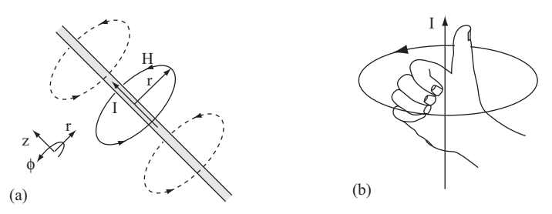
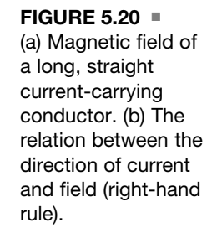
MAGNETIC FIELDS: SENSORS AND ACTUATORS
Introduction

Slide 37
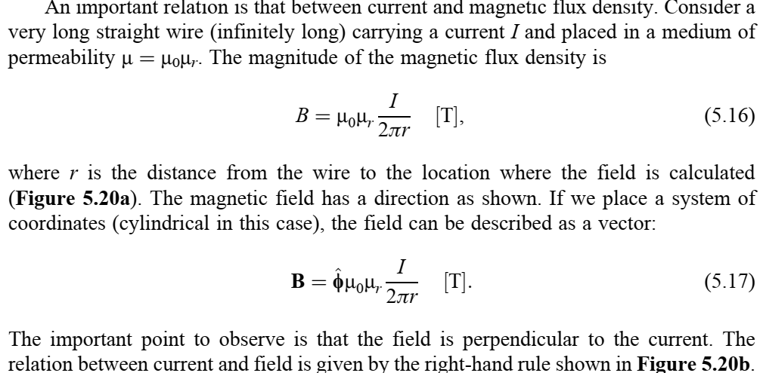
MAGNETIC FIELDS: SENSORS AND ACTUATORS
Introduction

Slide 38
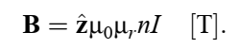
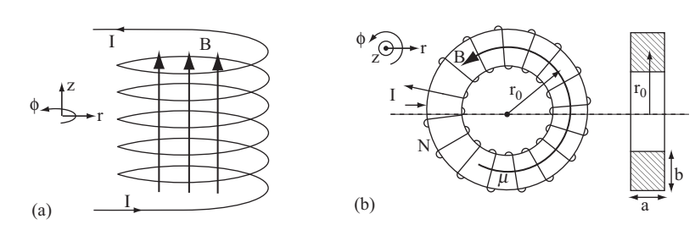
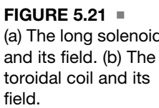
MAGNETIC FIELDS: SENSORS AND ACTUATORS
Introduction
In a long solenoid, with n turns per unit length (see Figure 5.21a), the magnetic flux density in the solenoid is constant, and with the geometry and system of coordinates shown is

Slide 39

MAGNETIC FIELDS: SENSORS AND ACTUATORS
Introduction

Slide 40

MAGNETIC FIELDS: SENSORS AND ACTUATORS
Introduction

Slide 41

MAGNETIC FIELDS: SENSORS AND ACTUATORS
Introduction

Slide 42

MAGNETIC FIELDS: SENSORS AND ACTUATORS
Introduction
In these important cases the force may be recast to act on the current rather than on charges. The starting relation is Equation (5.21) and the current density in a volume containing n charges per unit volume is

Slide 43

MAGNETIC FIELDS: SENSORS AND ACTUATORS
Introduction

Slide 44

MAGNETIC FIELDS: SENSORS AND ACTUATORS
Inductive Sensors
Inductance is defined as the ratio of magnetic flux and current
The unit of inductance is the henry (H). Inductance is independent of current since ϕ is linearly dependent on current

Slide 45



MAGNETIC FIELDS: SENSORS AND ACTUATORS
Inductive Sensors
We define two types of inductance:
Self inductance: the ratio of the flux produced by a circuit (a conductor or a coil) in itself and the current that produces it. That is, the flux in Equation (5.20) is the flux through the device itself. Usually denoted as Lii.
Mutual inductance: the ratio of the flux produced by circuit i in circuit j and the current in circuit i that produced it. Usually denoted as Mij.

Slide 46


MAGNETIC FIELDS: SENSORS AND ACTUATORS
Inductive Sensors
The concept of self-inductance is shown in Figure 5.23a, that of mutual inductance in Figure 5.23b. Thus any circuit (conductor, coil of conductors) has a self-inductance.
A mutual inductance exists between any two circuits as long as there is a magnetic field (flux) that couples the two when a current passes through either circuit. This coupling can be large (tightly coupled circuits) or small (loosely coupled circuits).
For example, for a long circular coil of radius r and with n turns/m, the self-inductance can be approximated as
The relation between voltage on an inductor and the current through it is strictly an AC relation given as
This voltage is called back-emf because its polarity opposes the polarity of the source that provides the current.

Slide 47



MAGNETIC FIELDS: SENSORS AND ACTUATORS
Inductive Sensors
If a loop or coil that contains N turns is placed in the field produced by a second coil, the induced voltage (often called induced electromotive force or emf) is
where the negative sign indicates a phase difference between the current producing the flux and the voltage induced in the coil.
The voltage induced in coil 2 due to the field produced by coil 1 would be -N₂dϕ₁₂/dt, where N₂ is the number of turns in the coil on the right and ϕ₁₂ is the flux produced by the coil on the left in the coil on the right.

Slide 48



MAGNETIC FIELDS: SENSORS AND ACTUATORS
Inductive Sensors
The coils, with N1 and N2 turns, respectively, produce fluxes when a current exists through them. All flux produced by coil 1 couples with coil 2 through the magnetic circuit made of a ferromagnetic material (iron, for example). The voltages and currents relate as follows,
Most inductive sensors rely on self-inductance, mutual inductance, or transformer concepts to operate. It should be remembered, however, that these are active elements and require connection to a source to produce an output.
The most common types of stimuli sensed by inductive sensors are position (proximity), displacement, and material composition.

Slide 49


MAGNETIC FIELDS: SENSORS AND ACTUATORS
1. Inductive Proximity Sensors
An inductive proximity sensor contains, at the very least, a coil (inductor) that, when a current passes through it, generates a magnetic field.
The coil has an inductance, which depends on the dimensions of the coil, number of turns, and materials around it. The current and the diameter of the coil define the extent to which the field projects away from the coil and therefore the range and span of the sensor.

Slide 50
MAGNETIC FIELDS: SENSORS AND ACTUATORS
1. Inductive Proximity Sensors
By measuring the voltage across the inductor, the impedance can be evaluated, and since Z = R + jwL (R is the ohmic resistance and w = 2πf is the angular frequency), the inductance L is immediately available as a measure of the position of the coil or proximity to the surface being sensed.
We assumed here that R is constant, but even if it is not, the impedance in air (nothing being sensed) is known and this can be used for calibration.
The advantage of the device in Figure 5.25 is its simplicity, but it is a highly nonlinear sensor, and in practical sensors a few things are done to improve its performance.

Slide 51


MAGNETIC FIELDS: SENSORS AND ACTUATORS
1. Inductive Proximity Sensors - Improvements
First, a ferromagnetic core is added to increase the inductance of the sensor. Most often this is made of a ferrite material.
Ferrites have the advantage of being high-resistance materials.
A shield may be placed around the sensor to prevent sensitivity to objects on the side of the sensor or at its back.
The net effect of the shield is to project the field in front of the sensor and hence increase both the field (inductance) and the span of the sensor.

Slide 52
MAGNETIC FIELDS: SENSORS AND ACTUATORS
1. Inductive Proximity Sensors - Improvements
In other sensors there are two coils, one serving as a reference and the other as a sensor (Figure 5.26b). The reference coil’s inductance remains constant and the two are balanced.
When a surface is sensed, the sensing coil’s inductance increases and the imbalance between the coils serves as a measure of distance (differential sensor).
Other sensors, like the one is Figure 5.26c, may employ a closed magnetic circuit, which tends to concentrate the magnetic field in the gaps, and usually do not require shielding since the magnetic field is constrained within the ferromagnetic material making up the core.

Slide 53




MAGNETIC FIELDS: SENSORS AND ACTUATORS
1. Inductive Proximity Sensors - Improvements
In this method, the magnetic flux is viewed as a ‘‘current,’’ the term NI (i.e., the product of the current) and the number of turns in a coil as a ‘‘voltage,’’ and a term called reluctance replaces the resistance in a regular circuit.
The reluctance of a member of the magnetic circuit of length l_{m} [m], permeability μ [H/m], and cross-sectional area S [m²] is,
The flux in the circuit is

Slide 54


MAGNETIC FIELDS: SENSORS AND ACTUATORS
2. Eddy Current Proximity Sensors
Eddy current
Eddy currents are loops of electrical current induced within conductors by a changing magnetic field in the conductor according to Faraday's law of induction. Eddy currents flow in closed loops within conductors, in planes perpendicular to the magnetic field.
The name eddy current comes from the fundamental property of AC magnetic fields to induce currents in conducting media (ferromagnetic or not). This is shown schematically in Figure 5.29.

Slide 55

MAGNETIC FIELDS: SENSORS AND ACTUATORS
2. Eddy Current Proximity Sensors
There are two related phenomena at work.
The currents produced in the conductor, called eddy currents because they flow in closed loops, cause a field that opposes the original field that produces them (Lenz’s law). This field reduces the net flux through the sensor’s coil.
Second, the currents flowing in the conductor being sensed dissipate power. The sensing coil is now forced to supply more power than it would otherwise supply and hence, given a constant current, its effective resistance increases.
An AC magnetic field penetrating into a conducting medium is attenuated exponentially from the surface inward (and so are the eddy currents and other related quantities):

Slide 56

MAGNETIC FIELDS: SENSORS AND ACTUATORS
2. Eddy Current Proximity Sensors

Slide 57

MAGNETIC FIELDS: SENSORS AND ACTUATORS
2. Eddy Current Proximity Sensors
A proximity sensor (either capacitive or inductive) can be used to sense distance.
However, except for very short distances, their transfer function is much too nonlinear and their span too small to be effective for this purpose.
For this reason proximity sensors are often used as switches to provide a clear indication when a certain, preset distance is reached.
Inductive proximity sensors

Slide 58

MAGNETIC FIELDS: SENSORS AND ACTUATORS
2. Eddy Current Proximity Sensors
Eddy current sensors:
Top:
100 kHz absolute sensor embedded in a dielectric medium.
Bottom:
400 kHz differential sensor embedded in ferrite.

Slide 59

MAGNETIC FIELDS: SENSORS AND ACTUATORS
2. Eddy Current Proximity Sensors
Eddy current sensors (differential) for the detection of flaws in tubing.
Top: 19 mm, 100 kHz sensor for stainless steel tubing in nuclear power plant steam generators.
Bottom:
8 mm, 200 kHz sensor for air conditioning tubing.

Slide 60


MAGNETIC FIELDS: SENSORS AND ACTUATORS
3. Position and Displacement Sensing: Variable Inductance Sensors
Changing the inductance of a coil is to provide it with a movable core as shown in Figure 5.34.
In this sensor, the further the movable core moves in, the smaller the reluctance of the magnetic path and the larger the inductance.
If the core is made of a ferromagnetic material, the inductance increases, whereas a conducting material reduces the inductance.
This type of sensor is called a linear variable inductance sensor.
By sensing the inductance, a measure of the position of the core is available.
The same configuration may be used to measure force, pressure, or anything else that can produce linear displacement.

Slide 61

MAGNETIC FIELDS: SENSORS AND ACTUATORS
3. Position and Displacement Sensing: Variable Inductance Sensors
A better displacement sensor is a sensor based on the idea of the transformer.
This is based on one of two related principles: either the distance between two coils of a transformer is varied (the coupling between the coils changes) or the coupling coefficient between the two coils is varied by physically moving the core while the two coils are fixed.
Both principles are shown in Figure 5.35.
Connecting the two coils in Figure 5.35a in series and measuring the inductance of the two coils. This arrangement is called a coil-displacement sensor .
L = L₁₁ + L₂₂ + 2L₁₂, where L₁₂ is the mutual inductance between them, given as
L₁₂ =k √L₁₁L₂₂

Slide 62

MAGNETIC FIELDS: SENSORS AND ACTUATORS
3. Position and Displacement Sensing: Variable Inductance Sensors
Assuming a constant AC voltage Vref is connected across the primary coil, the induced voltage in the secondary coil is the output voltage:
In Figure 5.35b, the same relation holds except that now the moving core changes the coupling between the coils, thus changing the output voltage across the second coil.

Slide 63


MAGNETIC FIELDS: SENSORS AND ACTUATORS
3. Position and Displacement Sensing: Variable Inductance Sensors

Slide 64
MAGNETIC FIELDS: SENSORS AND ACTUATORS
3. Position and Displacement Sensing: Variable Inductance Sensors
This is similar to the variable inductance sensor, but now there are two coils in the output circuit whose voltages subtract.
When the core is symmetrical about the coils (Figure 5.36a), the output of the sensor is zero. If the core moves to the left, the voltage on coil 2 decreases (Figure 5.36b) while the voltage on coil 1 remains the same, since only the coupling between the reference (primary) coil and coil 2 changes.
The total voltage now increases and its phase is, say, positive.
When the core moves to the right, the opposite happens, but the phase is opposite (negative in this case).
This change in phase is used to detect the direction of motion, whereas the output voltage is a measure of distance the core travels from the zero output position.
These devices are very sensitive and useful, and in a relatively small range of motion, the output is linear.
The reference coil is driven with a stable sinusoidal source at a constant frequency and the core is ferromagnetic.
The whole sensor is enclosed and shielded so that no field extends outside it and hence cannot be influenced by outside fields.

Slide 65


MAGNETIC FIELDS: SENSORS AND ACTUATORS
3. Position and Displacement Sensing: Variable Inductance Sensors
A variation of the LVDT is the rotary variable differential transformer (RVDT), intended for angular displacement and rotary position sensing.
In all respects it is identical in operation to the LVDT device, but the rotary motion imposes certain restrictions on its construction.
The RVDT is shown schematically in Figure 5.37 and includes a ferromagnetic core that couples with the secondary coils based on angular position.
The moving core is shaped to obtain linear output over the useful range of the sensor.

Slide 66

MAGNETIC FIELDS: SENSORS AND ACTUATORS
2. Hall Effect Sensors
The Hall effect was discovered in 1879 by Edward H. Hall. The effect exists in all conducting materials, but is particularly pronounced and useful in semiconductors. To understand the principle, consider a block of conducting medium through which a current of electrons is flowing caused by an external source, as shown in Figure 5.38.

Slide 67

MAGNETIC FIELDS: SENSORS AND ACTUATORS
2. Hall Effect Sensors
A magnetic flux density B is established across the conductor, making an angle q with the direction of the current (in Figure 5.38, θ= 90°). The electrons flow at a velocity v, and according to Equation (5.22), a force perpendicular to both the current and field is established on the flowing electrons.
Since the force is related to the electric field intensity as F = qE, we can write the electric field intensity in the conductor as
The index H indicates this is the Hall electric field and it is perpendicular to the direction of current flow.

Slide 68


MAGNETIC FIELDS: SENSORS AND ACTUATORS
2. Hall Effect Sensors
To rewrite this in terms of current flowing in the element, we note that the current density may be written as J = nqv [A/m²], where nq is the charge density (n is number of electrons per cubic meter and q is the charge of the electron). v is the average velocity of electrons.
Therefore the Hall electric field intensity is
The current density is the current I divided by the cross-sectional area perpendicular to the flow of current or J = I/Ld:
The force pulls the electrons toward the front surface of the conductor and therefore a voltage develops between the back (positive) and front (negative) surfaces.

Slide 69


MAGNETIC FIELDS: SENSORS AND ACTUATORS
2. Hall Effect Sensors
The potential difference is the integral of the electric field intensity E along the path of length L.
Because Hall elements are typically small, we may assume E is constant along L and write
This voltage is the Hall voltage. In particular, in measurements, the angle θ is typically 90° and the Hall voltage is given by
where d is the thickness of the hall plate, n is the carrier density [charges/m³], and q is
the charge of the electron [C].

Slide 70

MAGNETIC FIELDS: SENSORS AND ACTUATORS
2. Hall Effect Sensors

Slide 71


MAGNETIC FIELDS: SENSORS AND ACTUATORS
2. Hall Effect Sensors

Slide 72

MAGNETIC FIELDS: SENSORS AND ACTUATORS
2. Hall Effect Sensors

Slide 73


MAGNETIC FIELDS: SENSORS AND ACTUATORS
2. Hall Effect Sensors

Slide 74



MAGNETIC FIELDS: SENSORS AND ACTUATORS
2. Hall Effect Sensors

Slide 75



MAGNETIC FIELDS: SENSORS AND ACTUATORS
2. Hall Effect Sensors

Slide 76


MAGNETOHYDRODYNAMIC (MHD) SENSORS AND ACTUATORS
Introduction

Slide 77


MAGNETOHYDRODYNAMIC (MHD) SENSORS AND ACTUATORS
MHD Generator or Sensor

Slide 78

MAGNETOHYDRODYNAMIC (MHD) SENSORS AND ACTUATORS
MHD Pump or Actuator

Slide 79


MAGNETOHYDRODYNAMIC (MHD) SENSORS AND ACTUATORS
MHD Pump or Actuator

Slide 80



MAGNETOHYDRODYNAMIC (MHD) SENSORS AND ACTUATORS
MHD Pump or Actuator

Slide 81

MAGNETOHYDRODYNAMIC (MHD) SENSORS AND ACTUATORS
MHD Pump or Actuator

Slide 82


MAGNETOHYDRODYNAMIC (MHD) SENSORS AND ACTUATORS
MHD Pump or Actuator

Slide 83


MAGNETOMETERS
1. Coil Magnetometer
In this coil the emf (voltage) measured across the coil is,

Slide 84
MAGNETOMETERS
1. Coil Magnetometer
The relations show that the output is integrating (dependent on the coil’s area).
This basic device indicates that to measure local fields, the area of the coil must be small, that sensitivity depends on the size and number of turns, the frequency, and, from Figure 5.56, that only variations in the field (due to motion in Figure 5.56a or due to the AC nature of the field in Figure 5.56b) can be detected.
If the field is time dependent, it can be detected with stationary coils as well.

Slide 85

MAGNETOMETERS
2. The Fluxgate Magnetometer

Slide 86
MAGNETOMETERS
2. The Fluxgate Magnetometer
The idea of a fluxgate sensor is shown in Figure 5.58a. The basic principle is to compare the drive-coil current needed to saturate the core in one direction to that needed to saturate it in the opposite direction. The difference is due to the external field. In practice, it is not necessary to saturate the core, but rather to bring the core into its nonlinear range (see Figure 5.19). The magnetization curve for most ferromagnetic materials is highly nonlinear, so almost any ferromagnetic material is suitable.
In practice, the coil is driven with an AC source (sinusoidal or square, but more often a triangular source), and under no external field, the magnetization is uniform throughout the coil and hence the sense coil will produce zero output. An external magnetic field perpendicular to the sense coil changes the magnetization and, in effect, the core has now become nonuniformly magnetized, producing an emf in the sensing coil on the order of a few millivolts per microteslas [mV/µT].
The reason for the name fluxgate is this switching of the flux in the core in opposite directions. The same can be achieved by using a simple rod, as in Figure 5.58b. Now the two coils are wound one on top of the other and the device is sensitive to fields in the direction of the rod, but the principle is the same, the output relies on variations in permeability (nonlinearity) along the bar. A particularly useful configuration is the use of a magnetostrictive film (metglasses are a common choice), as shown in Figure 5.58b or a similar configuration.

Slide 87

MAGNETOMETERS
2. The Fluxgate Magnetometer
To better understand the operation of the fluxgate sensor, consider one particular and highly useful form, the so-called pulse-position fluxgate sensor. In this type of sensor, the current in the driving coil is triangular and produces a likewise triangular shaped flux in the core.
This flux may be considered a reference flux. An additional flux is produced by the external magnetic field—the field being measured. This flux either adds or subtracts from the internal, reference flux, but in any case, it produces an emf in the sensing coil.
This is the measured flux. The two emfs—one from the reference flux and the other from the measured flux—are then compared. Whenever the reference field is higher than the measured field, the output is high, and whenever it is lower, the output is zero

Slide 88

MAGNETOMETERS
3. The SQUID

Slide 89
MAGNETOMETERS
3. The SQUID
SQUID stands for superconducting quantum interference device. The SQUID is based on the Josephson junction, formed by two superconductors separated by a small insulating gap (discovered in 1962 by Brian David Josephson).
If the insulator between two superconductors is thin enough, the superconducting electrons can tunnel through it.
For this purpose the most common junction is the oxide junction in a semiconductor, but there are other types.
The base material is usually niobium or a lead (90%)–gold (10%) alloy with the oxide layer formed on small electrodes made of the base material that are then sandwiched to form the junction.

Slide 90
MAGNETOMETERS
3. The SQUID
There are two basic types of SQUIDs.
Radio frequency (RF) SQUIDs, which have only one Josephson junction and DC SQUIDs, which usually have two junctions.
DC SQUIDs are more expensive to produce, but are much more sensitive.
If two Josephson junctions are connected in parallel (in a loop), electrons, which tunnel through the junctions, interfere with one another. This is caused by a phase difference between the quantum mechanical wave functions of the electrons, which is dependent upon the strength of the magnetic field through the loop.
The resultant superconducting current varies with any externally applied magnetic field. The external magnetic field causes a modulation of the superconducting current through the loop, which can be measured (Figure 5.61).
The superconducting current is set up externally by the sense loop (a single loop as in Figure 5.61a is used to measure fields, while two loops as in Figure 5.61b are used to measure the gradient in the field).
The current may also be set up directly by the superconducting loop.
The output is the change in voltage across the junction due to changes in the current, and since the junction is resistive, this change is measurable following amplification.

Slide 91
MAGNETOMETERS
3. The SQUID
An RF SQUID operates in the same fashion except that there is only one junction and the loop is driven by an external resonant circuit that oscillates at high frequency (20–30 MHz).
Any change in the internal state of the flux in the measurement loop (due to external, sensed fields) changes the resonant frequency, which is then detected and is a measure of the field.
The main difficulty with SQUIDs is the cooling needed and the necessary bulk.
Nevertheless, it is an exceedingly useful sensor where and when the cost can be justified.

Slide 92

MAGNETIC ACTUATORS
Introduction
The main reason that magnetic actuation is usually the best choice has to do with energy density, just as the reason for the use of the internal combustion engine has to do with energy density.
If we restrict ourselves to electrical actuation, there are two basic types of forces that exist.
One is the Coulomb force, which acts on a charge in the electric field.
The second is the magnetic force, which acts on a current in a magnetic field as defined by the Lorentz force

Slide 93

MAGNETIC ACTUATORS
Introduction

Slide 94
MAGNETIC ACTUATORS
Introduction
They are also useful in electrostatic filters and dust collectors, where the small forces are sufficient to act on charged dust particles and collect them on electrodes.
Electrostatic actuation is also critical to the operation of copiers and printers, where toner particles are distributed on a printing medium using electrostatic forces.

Slide 95


MAGNETIC ACTUATORS
Voice Coil Actuators

Slide 96
MAGNETIC ACTUATORS
Voice Coil Actuators
In most applications of voice coil actuators, there is no use of voice—only the similarity in operation.
The actuators are based on the interaction between the current in a coil and the magnetic field of a permanent magnet or another coil.
The magnetic field in the gap is radial.
L is the circumference of the loop and we assume a uniform magnetic field. With N turns, the force is NBIL.
Of course, the field does not have to be uniform or the coil circular, but this is a simple configuration and is the one used in most speakers.
The larger the current, the larger the force, and thus the larger the displacement of the speaker’s cone.
By reversing the current, the coil moves in the opposite direction.

Slide 97
MAGNETIC ACTUATORS
Voice Coil Actuators
The force is directly proportional to current for a given magnetic field. In this case (and in many voice coil actuators) it is linear with current, an important property of the device.
The larger the coil or the magnetic field, the larger the force.
By allowing the coil to move, the displaced mass is small (compared with other actuators) and hence the mechanical response is rather good. For this reason, a speaker can operate at, say, 15 kHz, whereas a motor-driven actuator may take seconds to reverse.
It is also possible to fix the coil and allow the magnet to move.
The field in the actuator can be generated by an electromagnet if necessary.
We note here that the voice coil actuator can be turned into a sensor by simply reversing the action. If we move the coil in the magnetic field, the voltage induce in the coil will be given by Faraday’s law of induction. The speaker becomes a microphone and the more general voice coil actuator becomes a sensor.
In the absence of current, the actuator is entirely disengaged—there is no intrinsic retaining or cogging force and no friction. However, in some cases use may be made of a restoring spring to return the actuator to its rest position, as is done in speakers.
The motion is limited and often quite short.
Rotational motion can also be achieved by selecting particular coil and magnet configurations (see Figure 5.63b).
The actuator is a direct drive device.

Slide 98



MAGNETIC ACTUATORS
Voice Coil Actuators
Voice coil actuators are often used where very accurate positioning at high speeds is needed. Since they have no hysteresis and minimal friction, they are extremely accurate both as linear and as angular positioners.

Slide 99
MAGNETIC ACTUATORS
Motors as Actuators
Also to be recognized at this stage is that most motors are magnetic devices—they operate by attraction or repulsion between current-carrying conductors or between current-carrying conductors and permanent magnets in a manner similar to that of voice coil actuators.
Unlike voice coil actuators, motors include magnetic materials (mostly iron), in addition to permanent magnets or electromagnets, to increase and concentrate the magnetic flux density and in so doing increasing power, efficiency, and available torque in the smallest possible volume.
The variation in size, and power, they can deliver is staggering. Some motors are truly tiny.
Motors, as their name implies, deliver motion in one form or another. As such, many devices can be called motors.

Slide 100
MAGNETIC ACTUATORS
Motors as Actuators
As a general classification for actuation purposes, there are three types of motors:
continuous rotational motors,
stepper motors, and
linear motors.
The best known to the casual observer is the continuous rotational motor.
However, stepper motors are much more common than one realizes, and linear motors, while not as common, are increasingly finding application in specialized systems.
In a continuous motor, the shaft rotates in one direction as long as power is supplied to the motor.

Slide 101
MAGNETIC ACTUATORS
Motors as Actuators
Stepper motors provide discrete motion or steps of predetermined size. A pulse given to the motor will move it a fraction of a rotation (1–5 is typical).
To move it further, an additional pulse is necessary. This is a boon to positioning, where the accurate and repeatable steps of these motors is very useful.
Linear motors are somewhere in between.
First, their motion is linear rather than rotational.
Because of this, they cannot be truly continuous and must be reversible.
Often they are stepping motors, but they can be continuous in the range of their linear motion.
One may need to control the speed, direction of motion, number of steps, torque applied, etc. These controls are often accomplished with microprocessors and interfacing circuits

Slide 102

MAGNETIC ACTUATORS
Motors as Actuators - Operation Principles

Slide 103



MAGNETIC ACTUATORS
Motors as Actuators - Operation Principles

Slide 104


MAGNETIC ACTUATORS
Motors as Actuators - Operation Principles

Slide 105


MAGNETIC ACTUATORS
Motors as Actuators - Operation Principles

Slide 106


MAGNETIC ACTUATORS
Motors as Actuators - Operation Principles

Slide 107


MAGNETIC ACTUATORS
Brushless, Electronically Commutated DC Motors (BLDC Motors)

Slide 108


MAGNETIC ACTUATORS
Brushless, Electronically Commutated DC Motors (BLDC Motors)

Slide 109

MAGNETIC ACTUATORS
Brushless, Electronically Commutated DC Motors (BLDC Motors)

Slide 110


MAGNETIC ACTUATORS
Brushless, Electronically Commutated DC Motors (BLDC Motors)

Slide 111


MAGNETIC ACTUATORS
Brushless, Electronically Commutated DC Motors (BLDC Motors)

Slide 112


MAGNETIC ACTUATORS
AC Motors

Slide 113
MAGNETIC ACTUATORS
AC Motors
The AC field and the coil act as a transformer and an AC current is induced in the coil because it is shorted. According to Lentz’s law, the current in the coil must produce an opposing field, which then forces the coil to rotate. Since now there is no commutation, continuous rotation is achieved by rotating the field.
This can then be switched on after the loop has rotated one-half turn to keep it going. In practice this is done somewhat differently, by using the phases of the AC power supply to form a rotating field, shown schematically in Figure 5.74 for a three-phase AC motor (a magnet is shown for the rotor, but a shorted coil acts exactly as a magnet).
As the phases of the supply change with time, they generate a rotating magnetic field that drags the rotor with it, affecting the rotation.

Slide 114
MAGNETIC ACTUATORS
AC Motors
Induction machines are very common in appliances since they are quiet, efficient, and most importantly, rotate at constant speeds that depend only on the frequency of the field and the number of poles.
They are also used in control devices where constant speed is important.
Control of induction motors, other than on and off, is much more involved than for DC motors, especially when variable speed is desired.

Slide 115


MAGNETIC ACTUATORS
AC Motors

Slide 116
MAGNETIC ACTUATORS
Stepper Motors
In actuation, the control of a motor for, say, exact and repeatable positioning requires, in addition to a continuous motor, some means of feedback, counting rotations, sensing position, etc.
Motors that incorporate these means are called servomotors and they are commonly used in various control systems.
In some applications servomotors have been replaced by stepper motors.
Stepper motors are incremental rotation or linear motion motors. For this reason they are often viewed as ‘‘digital’’ motors, in the sense that each increment is fixed in size and increments are generated by a train of pulses.

Slide 117


MAGNETIC ACTUATORS
Stepper Motors

Slide 118

MAGNETIC ACTUATORS
Stepper Motors

Slide 119
MAGNETIC ACTUATORS
Stepper Motors
The sequence indicates the following:
The size of the step (number of steps) depends on the number of coils and, as we shall see later, the number of poles in the rotor.
Full stepping (90 in this case) can be accomplished by using only one of the stator coils (single phase) at each step.
More coils and more poles in the rotor will produce smaller steps.
The number of poles in the rotor and in the stator must be different (fewer poles in the rotor).
The magnetic field in the rotor can be generated by permanent magnets or by coils. We shall see that neither is really necessary. A stepper motor can be made with an iron rotor alone.

Slide 120
MAGNETIC ACTUATORS
Stepper Motors
Consider again Figure 5.76, but suppose that the permanent magnet in the rotor is replaced with a piece of iron (nonmagnetized). The operation indicated above is still valid since the magnetic field produced by the stator coils will magnetize the iron (i.e., an electromagnet will attract a piece of iron).
This simplifies matters considerably since now the rotor is much simpler to make. This type of stepper motor is called a variable reluctance stepping motor and is a common way of producing stepper motors.
The principle of the motor is shown in Figure 5.77a. To operate it, the coils marked as 2 are first energized. This moves the rotor one step counterclockwise. Then coils marked as 3 are energized, moving one step to the left, and so on.
Rotation in the opposite direction is obtained by inverting the sequence (driving coil number 3 first, then 2, and so on).

Slide 121

MAGNETIC ACTUATORS
Stepper Motors

Slide 122

MAGNETIC ACTUATORS
Stepper Motors

Slide 123

MAGNETIC ACTUATORS
Stepper Motors
Half-stepping is possible by proper driving following the principles outlined above. For example, by driving first coil 1 we obtain the situation shown in the figure.
If coils 1 and 2 are driven at the same time, the rotor will move counterclockwise one-half step.
This stepper motor is capable of full steps of 15. The motor is a three phase stepper motor since the sequence to drive it in either direction repeats after three steps.
Note that here the number of poles in the stator is larger than in the rotor.
The opposite is just as valid and is often used in conjunction with variable reluctance stepper motors.

Slide 124


MAGNETIC ACTUATORS
Stepper Motors
In an attempt to make motors with increasingly finer pitch (smaller steps), multiple rotors on a single shaft are used.
These are called multiple stack stepper motors and they allow much finer steps by keeping one of the set of poles (on the rotor or on the stator) equal but changing the pitch on the opposite set of poles.
Since now the pitch varies between stacks rather than within one stack, finer pitches are possible.
The disadvantage is that the driving sequence is more complicated than in a single rotor motor.

Slide 125


MAGNETIC ACTUATORS
Stepper Motors
One can find stepper motors in industrial controls as easily as in consumer products such as printers, scanners, and cameras.

Slide 126

MAGNETIC ACTUATORS
Linear Motors
A linear motor, either incorporating continuous motion or stepper motion, can be viewed as a rotary motor that has been cut and flattened so that the rotor can now slide linearly over the stator.
This is shown schematically in Figure 5.81.

Slide 127


MAGNETIC ACTUATORS
Linear Motors
A variable reluctance linear stepping motor may be built as shown in Figure 5.82.
This motor is equivalent to the rotary motor in Figure 5.77a.
In the motor described here, the sequence is 1-3-2 for motion to the right. Moving in the opposite direction is accomplished by changing the sequence to (3-1-2).

Slide 128


MAGNETIC ACTUATORS
Linear Motors
Some aspects of their use, including starting methods for AC machines, inverters, power supplies, protection methods.

Slide 129


MAGNETIC ACTUATORS
Magnetic Solenoid Actuators and Magnetic Valves
‘‘virtual displacement method”

Slide 130


MAGNETIC ACTUATORS
Magnetic Solenoid Actuators and Magnetic Valves
A coil generates a magnetic field everywhere, including in the gap between the fixed and movable iron pieces. We shall call the movable piece a plunger.
The magnetic flux density in the air gap between the plunger and the fixed iron piece is,
The force exerted on the plunger is given as
In this form, the device is used as a simple go/no go actuator.
That is, when energized, the gap is closed, and when deenergized it is open.
This type of device is often used for electrical release of latches on doors, as a means of opening/closing fluid or gas valves, or to engage a mechanism.

Slide 131




MAGNETIC ACTUATORS
Magnetic Solenoid Actuators and Magnetic Valves

Slide 132


MAGNETIC ACTUATORS
Magnetic Solenoid Actuators and Magnetic Valves
The basic solenoid actuator is often used as the moving mechanism in valves.
The control of both fluids and gases and exist in a variety of sizes, constructions, and power levels.
They can be found not only in industrial processes, but also in consumer appliances such as washing machines, dishwashers, and refrigerators, as well as in cars and a variety of other products.
The actuating rod (plunger) in this case acts against a spring and by properly driving the current through the solenoid its motion can be controlled as to speed and force exerted.
Similar constructions can operate and control almost anything that requires linear (or rotational) motion. However, the travel of the actuating rods is relatively small, on the order of 10–20 mm, and often much less.

Slide 133


MAGNETIC ACTUATORS
Magnetic Solenoid Actuators and Magnetic Valves

Slide 134



VOLTAGE AND CURRENT SENSORS
There are many mechanisms for sensing current and voltage. The most common methods are resistive and inductive, but the Hall element can be used successfully
Voltage Sensing

Slide 135


VOLTAGE AND CURRENT SENSORS
Voltage Sensing

Slide 136


VOLTAGE AND CURRENT SENSORS
Voltage Sensing

Slide 137


VOLTAGE AND CURRENT SENSORS
Voltage Sensing

Slide 138

VOLTAGE AND CURRENT SENSORS
Current Sensing

Slide 139

VOLTAGE AND CURRENT SENSORS
Current Sensing

Slide 140


VOLTAGE AND CURRENT SENSORS
Current Sensing

Slide 141

VOLTAGE AND CURRENT SENSORS
Current Sensing

Slide 142


VOLTAGE AND CURRENT SENSORS
Current Sensing

Slide 143
Problems

Slide 144


Slide 145


Slide 146


Slide 147


Slide 148


Slide 149


Slide 150


Slide 151


Slide 152



Slide 153


Slide 154


Slide 155


Slide 156


Slide 157


Slide 158


Slide 159


Slide 160


Slide 161


Slide 162


Slide 163


Slide 164


Slide 165



Slide 166


Slide 167


Slide 168


Slide 169


Slide 170



Slide 171


Slide 172


Slide 173



Slide 174


Slide 175


Slide 176



Slide 177


Slide 178


Slide 179


Slide 180



